Slide 1
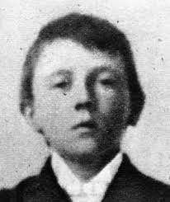
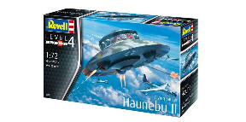
Evidence For Currently Classified 3rd Reich Technological Discoveries
Prepared by Josh Perkins
Laughed at by Josh Kaleel, etc.
Notes:
How it started, how it's going.

Slide 2
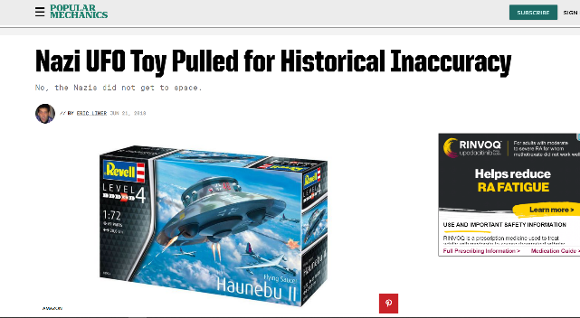
The coverup continues today.
A model of the nonexistent Nazi UFO "Haunebu II" produced by model company Revell will no longer be produced after criticism about its historical inaccuracy. The model's packaging, which falsely proclaimed the "round aircraft" was the first object able to fly in space with a top speed of 6000 kph (over 3700 mph), failed to mention that the craft was never built, drawing fire from The German Children's Protection Association (DKSB) and Dresden's Military History Museum (MHM), according to German publication, The Local.
https://www.popularmechanics.com/military/research/a21750317/nazi-ufo-model-taken-off-shelves-for-historical-inaccuracy/

Slide 3
New Swabia or NeuSchwaben Land
https://en.wikipedia.org/wiki/New_Swabia

Slide 4
Some Historical Photos

Slide 5
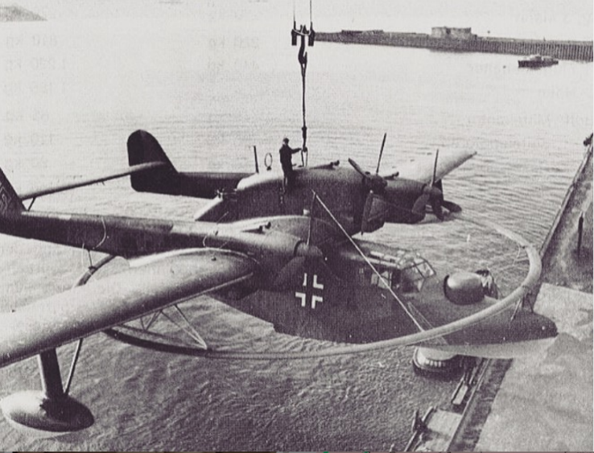
Some Historical Photos

Slide 6
Some Historical Photos

Slide 7
Some Historical Photos

Slide 8
Some Historical Photos

Slide 9
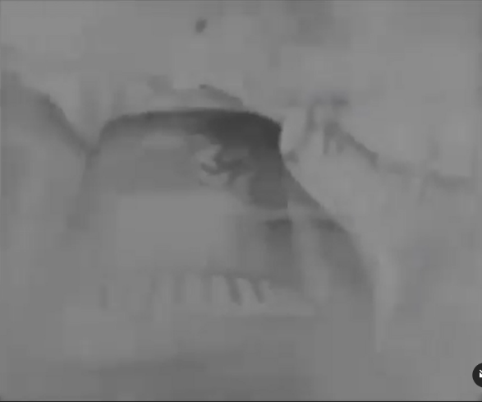
Some Historical Photos
https://www.instagram.com/p/B-IoApEgx3J/

Slide 10
Some Historical Photos

Slide 11
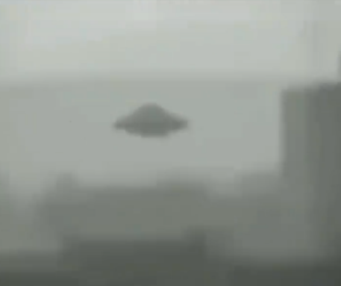
Some Historical Photos
https://www.instagram.com/p/CE3surkDWFv/
1939

Slide 12
Some Historical Photos

Slide 13
Some Historical Photos

Slide 14
Some Historical Photos

Slide 15
Some Historical Photos

Slide 16
Some Historical Photos

Slide 17
Some Historical Photos

Slide 18
Some Historical Photos

Slide 19
Some Historical Photos

Slide 20
Some Historical Photos

Slide 21
Some Historical Photos

Slide 22
Some Historical Photos

Slide 23
Some Historical Photos

Slide 24
Some Historical Photos

Slide 25
https://www.popularmechanics.com/military/research/a36560537/hitler-nazi-anti-gravity-machine-ufo-die-glocke-conspiracy-video/

